Slide 1
PHP-Forum Database
Entities | Attributes
User | Username, password
Post | Post-ID, topic-ID, username, comment
Topic | Topic-ID, title, description, username
Relationships | Type | Explained
User <-> Post | One-to-one | Each post has only one owner.
User <-> Topic | One-to-one | Each topic has only one owner.
Topic <-> Post | One-to-one | Each post can belong only to one topic.

Slide 2

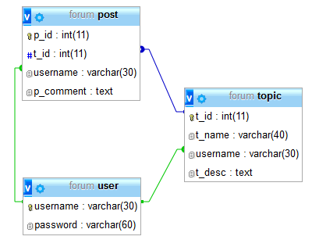
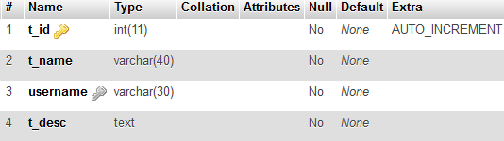
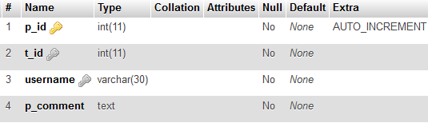
Table designs
Table: user
Relational schema
Table: topic
Table: post

